Slide 1
Recommender Systems Part 1
Dilrukshi Keerthirathna
Kalpana Randeniya

Slide 2
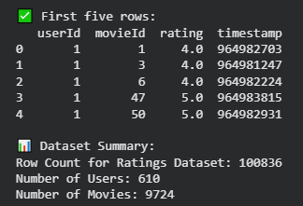
MovieLens 100K rating dataset

Slide 3
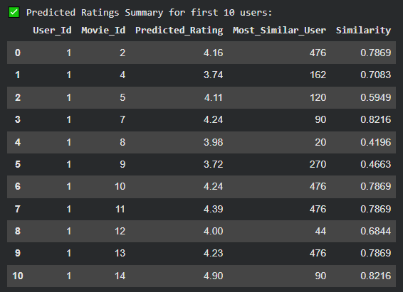
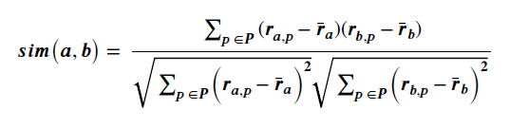

User-Based Collaborative Filtering (CF) Pearson Correlation
Similarity calculation
Following formula is used to find the similarities between users
Prediction function
The formula below is used to estimate a user's unknown movie rating by incorporating the rating patterns of similar users

Slide 4
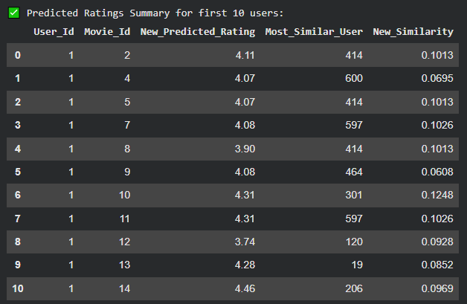
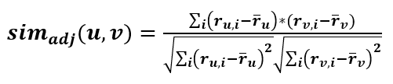
New similarity function Adjusted Cosine Similarity
This similarity measure normalizes each user’s ratings by subtracting their average rating. This reduces personal rating bias and ensures a fair comparison between users who may have different rating habits or scales who rate differently.

Slide 5
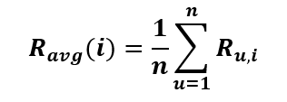

Group Recommendation
After computing the movies recommendations for each user in the group, then aggregate the lists of 5 users to produce a single list of movies for the group using below methods.
Average Method
Compute predicted rating for each user in the group
Ensures equal weight for all group members
May be less effective if preferences differ strongly
Least Misery Method
Prevents selecting items that any member dislikes
Ensures group satisfaction by avoiding dissatisfaction
Best for joint activities requiring agreement

Slide 6
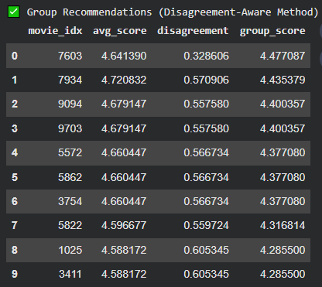


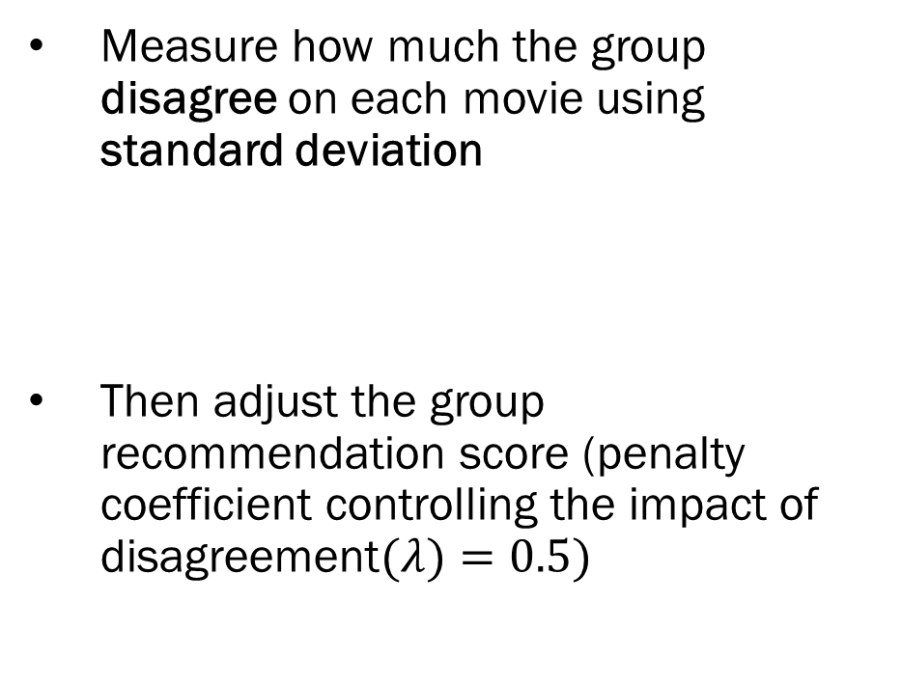
Disagreement Aware Method
Measure how much the group disagree on each movie using standard deviation
Then adjust the group recommendation score ($\text{penalty} \text{coefficient} \text{controlling} \text{the} \text{impact} \text{of} \text{disagreement}(λ)=0.5)$

Slide 7
Pros of Using Standard Deviation for Measuring User Disagreement
📊 Intuitive and easy to interpret
⚖️ Reflects strength of disagreement
🧮 Statistically sound
🔁 Smooth and continuous measure
📏 Same scale as ratings
👥 Detects polarization
🌍 Scalable for any group size

Slide 8
Thank You

